Slide 1

TOP DOWN APPROACH
Add subtitle here

Slide 2

Overview
What is the Top-down approach?
Steps to execute the Top-down approach
How can we apply to Top-down approach in our life

Slide 3

WHAT IS TOP-DOWN APPROACH

Slide 4

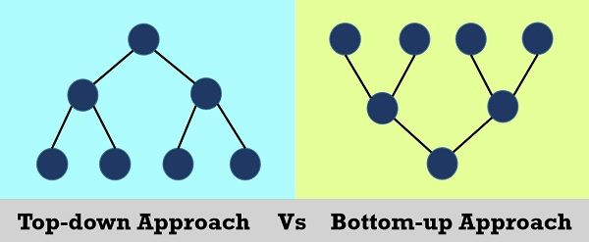
What is top-down approach?
It is a strategic method by which we will view the whole problem and then break down it into smaller, and more specific details
For example:
In programming, we will focus on the overall structure of a program and then we will break it into smaller and more manageable components. It means we will the outline firsts and then refining each components later.

Slide 5
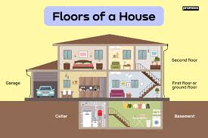
Example:
At first we will stretch out our program.
After that we will break down it into more smaller components
Next, we will define each component more specific until the whole system is completed.
Program
Component A
Component B
Component C
Deatail 1
Detail 2
Deatail 1
Detail 2
Deatail 1
Detail 2

Slide 6
Advantages and disadvantages
Advantages:
-Help us to understand the big picture of the problem, therefore we can see the goal more clearly.
-Help us to identify the prioritization of each tasks.
=>We can locate the resources more effectively.
-By break down the systems or projects into smaller components, we can manage them more easily and effectively.
Disadvantages:
We may ignore the specific details.
Because we view the goal before starting implementation so if there are any changes, we have to start from the beginning again.
It is also hard to adapting new requirements during the implementation stages.

Slide 7






HOW I APPLY IT IN REAL LIFE

Slide 8
ECOMERCE WEBSITE
HOMEPAGE
USER PAGE
User/api
PRODUCT PAGE
Product api

Slide 9
ECOMERCE WEBSITE
HEADER
LOGO
Other elements
Component 1
Component 2
Component 3
Element 1
Element 2
Element 3
FOOTER

Slide 10


THANK YOU FOR LISTENING
10

